Slide 1
Gaussian Mixture Model with Variational Inference
Name : 李權桓(Jack Li)
Student ID: D10546004
Subject Name: Nonlinear Programming

Slide 2
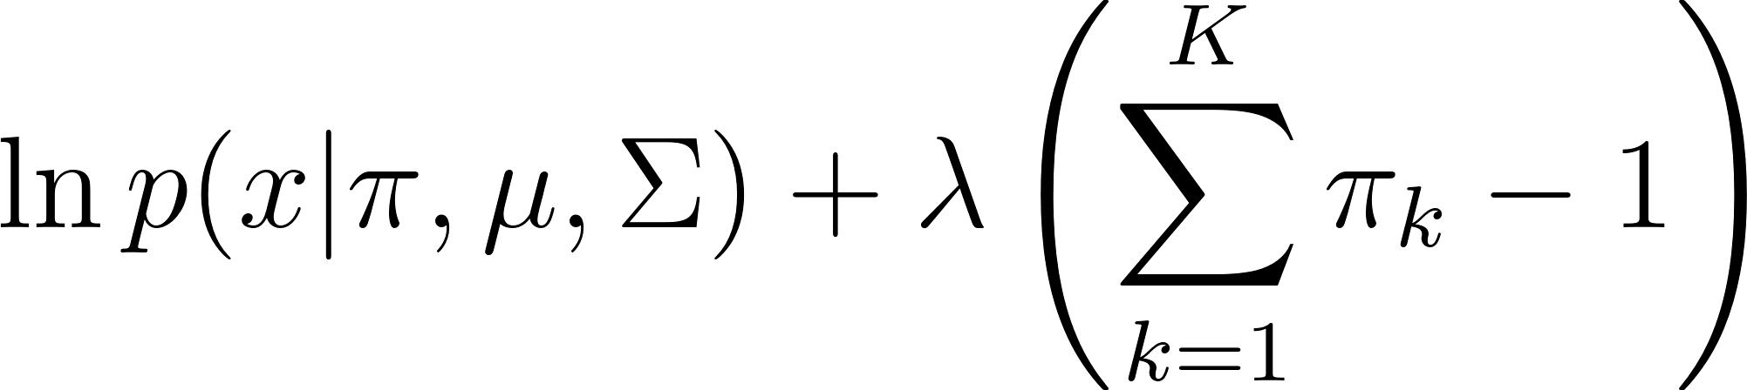
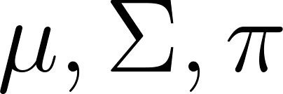
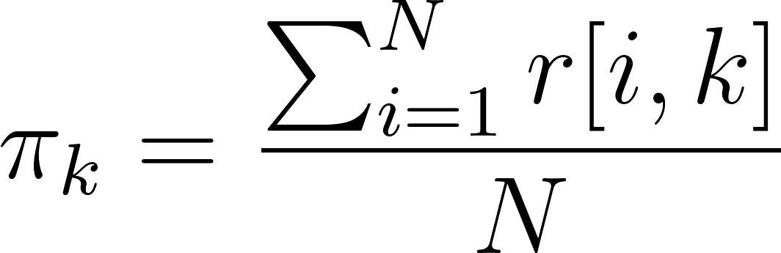
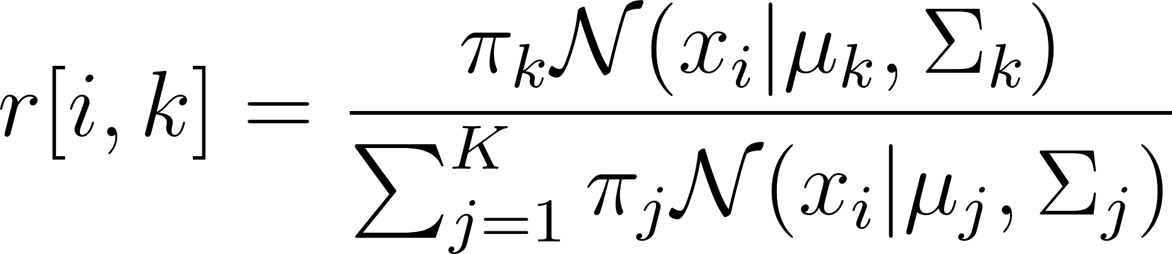
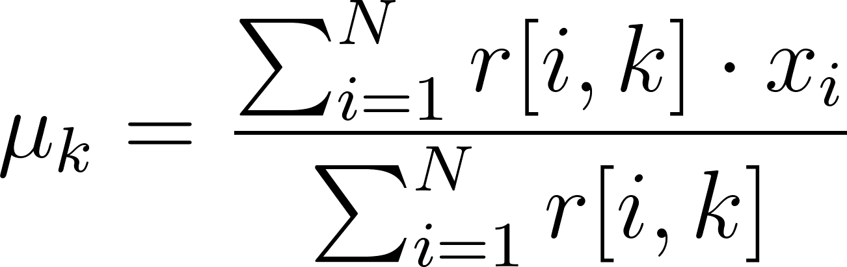
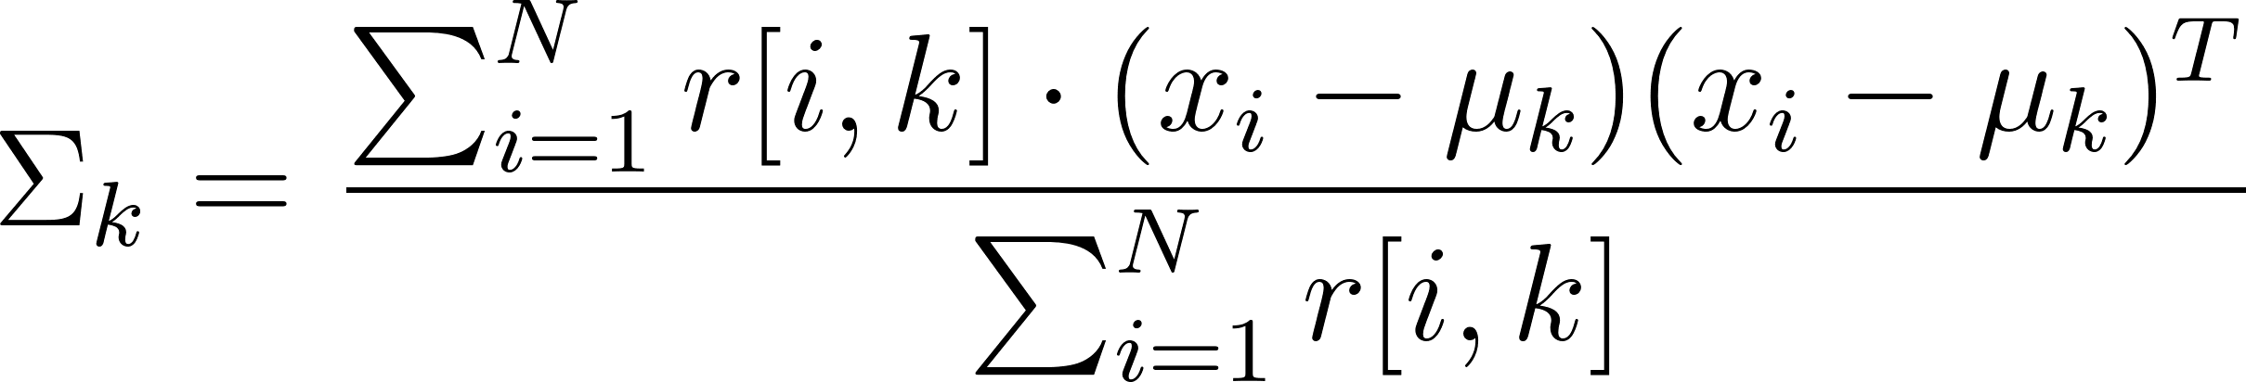
GMM algorithm
E - Step
M - Step

Slide 3
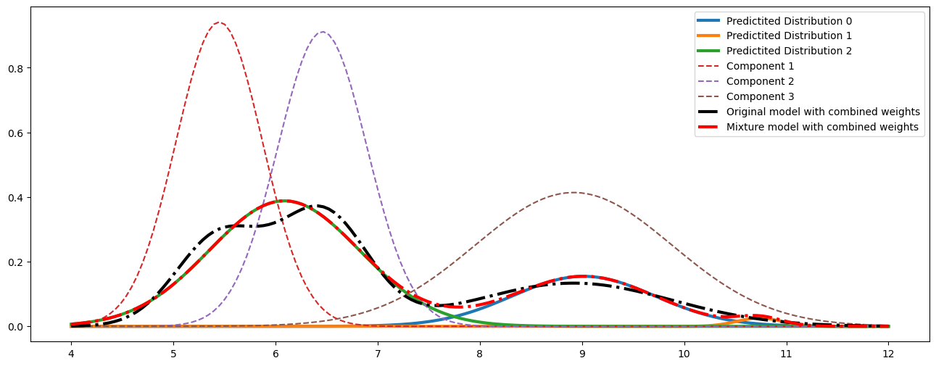
Problem scenario 1
X : [0.27109111 0.01420764 0.71470124],
mu: [ 9.01648564 10.73647351 6.08668571],
std: [0.69868933 0.22180447 0.73436439]
Original std: [0.4236, 0.4376, 0.9637]

Slide 4
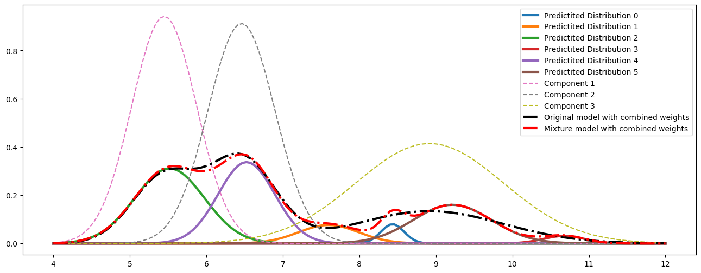
Problem scenario 2
X : [0.3550 0.0209 0.2057 0.0303 0.3125 0.0753],
mu: [ 5.5189 10.67429 9.2149 8.4331 6.524911 7.5983],
std: [0.4553 0.2701 0.51205 0.15114 0.36980 0.39282]
Original std: [0.4236, 0.4376, 0.9637]

Slide 5
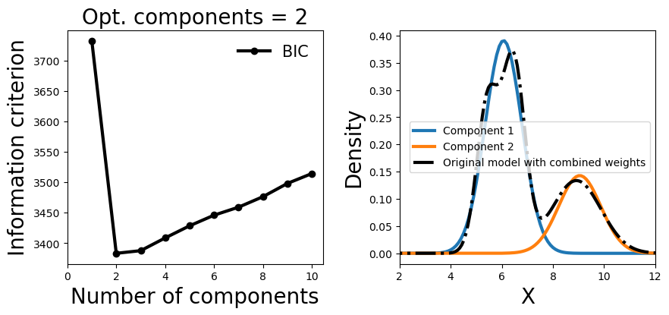
Optimal components With Bayesian Information Criterion

Slide 6
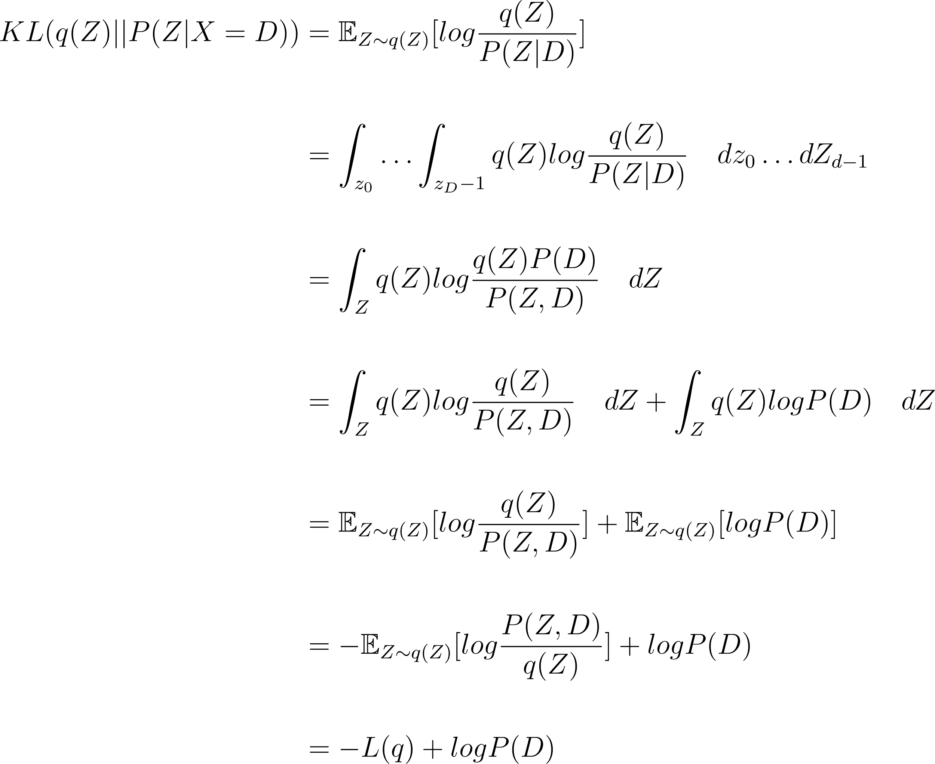

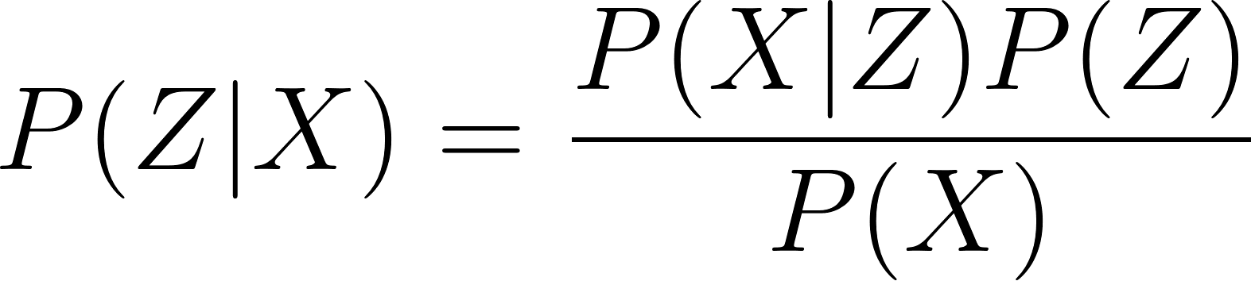

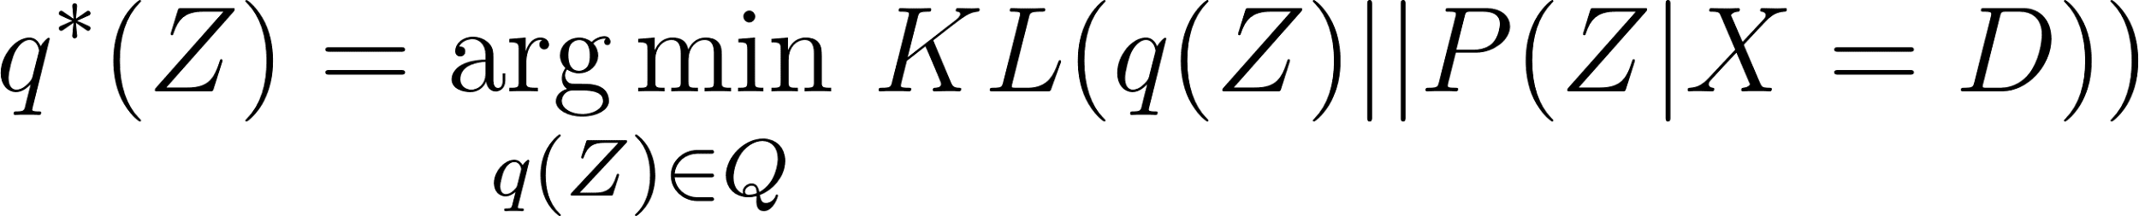
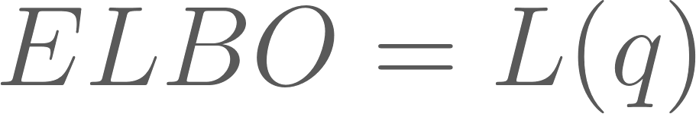
Variational inference
Posterior
Use surrogate q(Z|X)
Prior

Slide 7
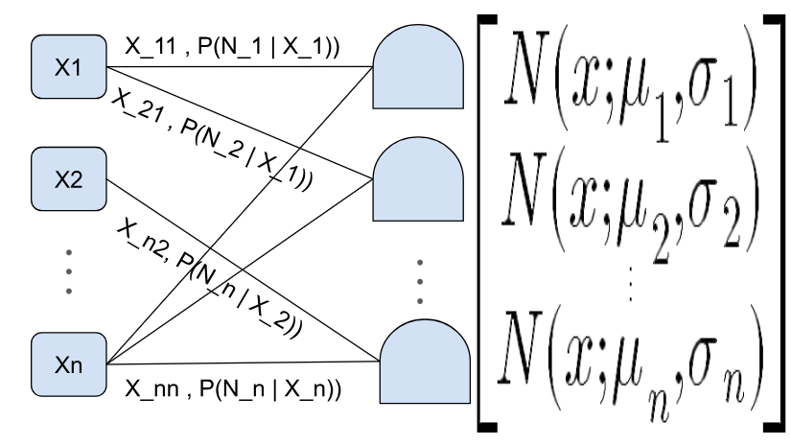
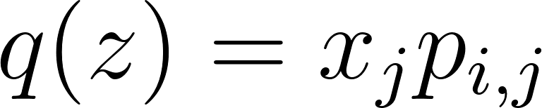
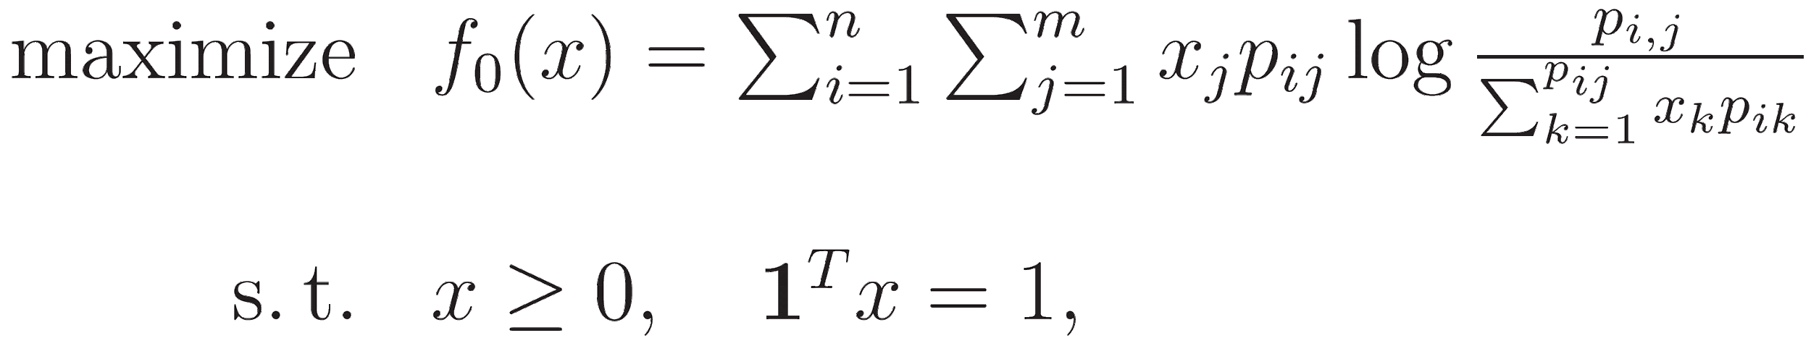

GMM with VI
Stop iteration when

Slide 8
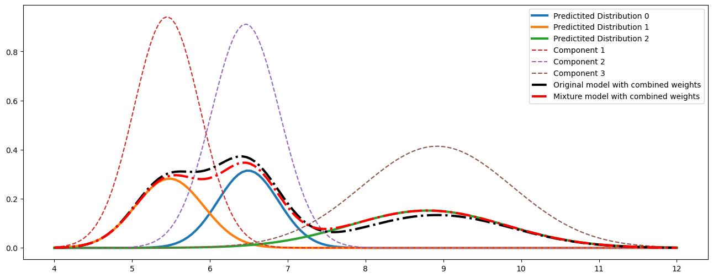
Experiments results
X : [0.30739646 0.30970736 0.38289618],
mu: [6.4922638 5.4806742 8.79821412],
std: [0.38949513 0.43832324 1.00545024]
Original std: [0.4236, 0.4376, 0.9637]

Slide 9
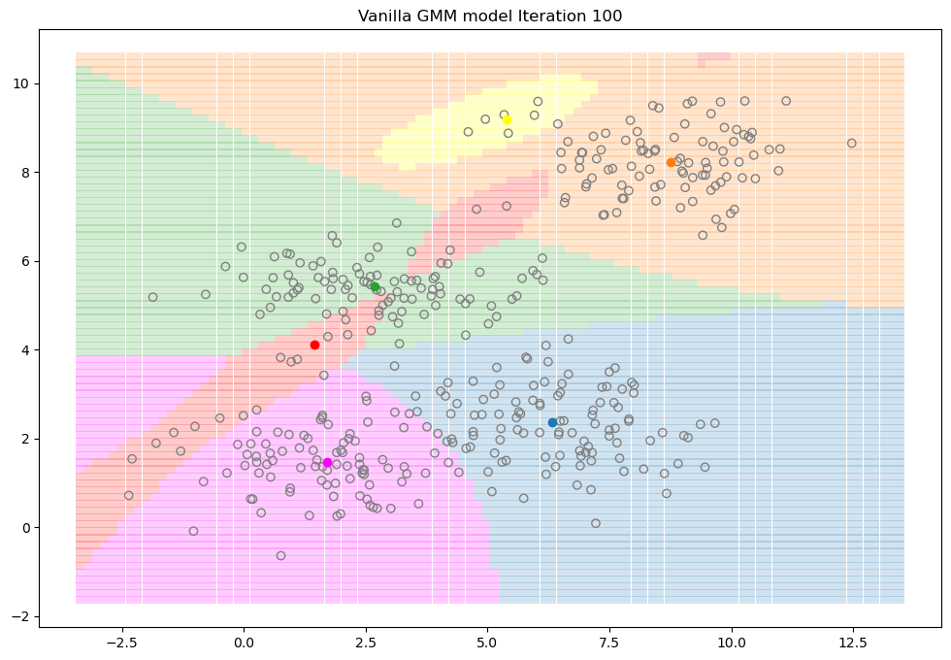
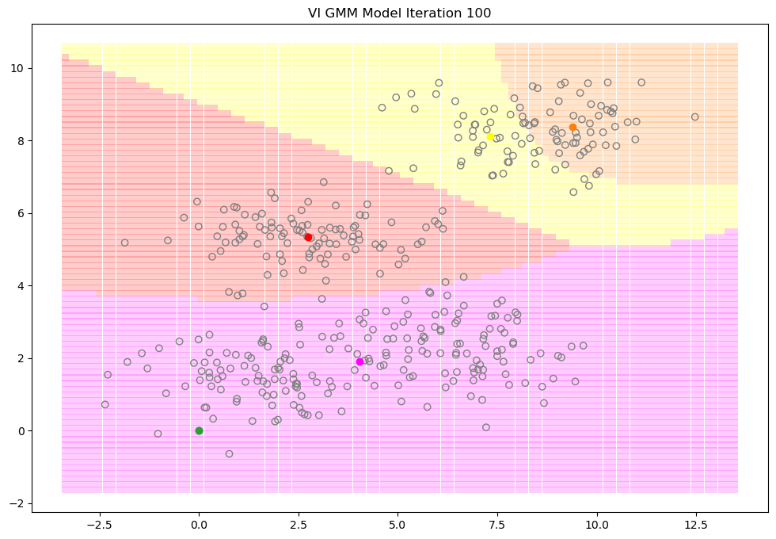
2-D Experiments results

Slide 10
Vanilla GMM model: weights: [0.26594647 0.23062394 0.22338953 0.22630703 0.01443529 0.03927455], means: [[6.32213808 2.35767698] [8.75275074 8.2155947 ] [2.67778884 5.43553413] [1.71303902 1.46485518] [5.3869087 9.19282174] [1.4555381 4.10617346]], cov: [[[ 2.38092292 -0.27707638] [-0.27707638 0.70244211]] [[ 1.77909436 0.16122733] [ 0.16122733 0.49937488]] [[ 2.80589061 -0.11374297] [-0.11374297 0.24995371]] [[ 1.88645364 0.07396465] [ 0.07396465 0.52119153]] [[ 0.26950374 0.08554552] [ 0.08554552 0.05829775]] [[ 6.17115731 4.81799474] [ 4.81799474 3.84442762]]] | VI GMM Model: weights: [3.57306088e-11 2.32240414e-01 3.57306088e-11 2.95132962e-01 1.65161887e-01 3.07464738e-01], means: [[0. 0. ] [9.39217567 8.38590059] [0. 0. ] [4.03528407 1.9113075 ] [7.32249954 8.10698907] [2.74723794 5.33736873]], cov: [[[ 1.00000000e-04 0.00000000e+00] [ 0.00000000e+00 1.00000000e-04]] [[ 1.10218465e+00 9.28470182e-02] [ 9.28470182e-02 4.74811277e-01]] [[ 1.00000000e-04 0.00000000e+00] [ 0.00000000e+00 1.00000000e-04]] [[ 8.12813397e+00 8.62306637e-01] [ 8.62306637e-01 7.40959782e-01]] [[ 1.65220708e+00 -4.78582925e-01] [-4.78582925e-01 5.48463200e-01]] [[ 2.88096356e+00 -8.83487528e-02] [-8.83487528e-02 4.05972940e-01]]]

Slide 11
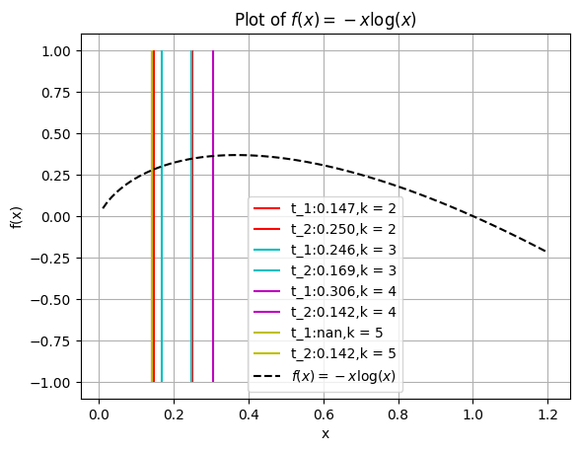
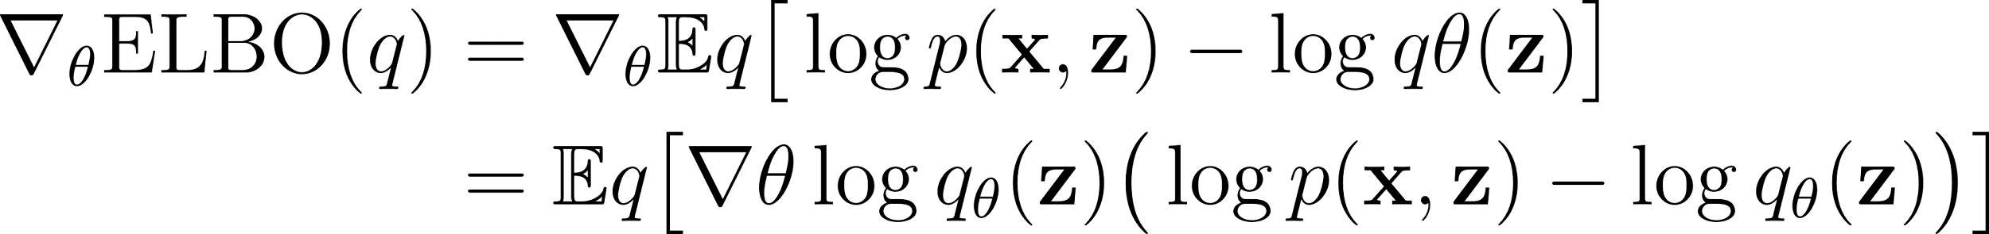
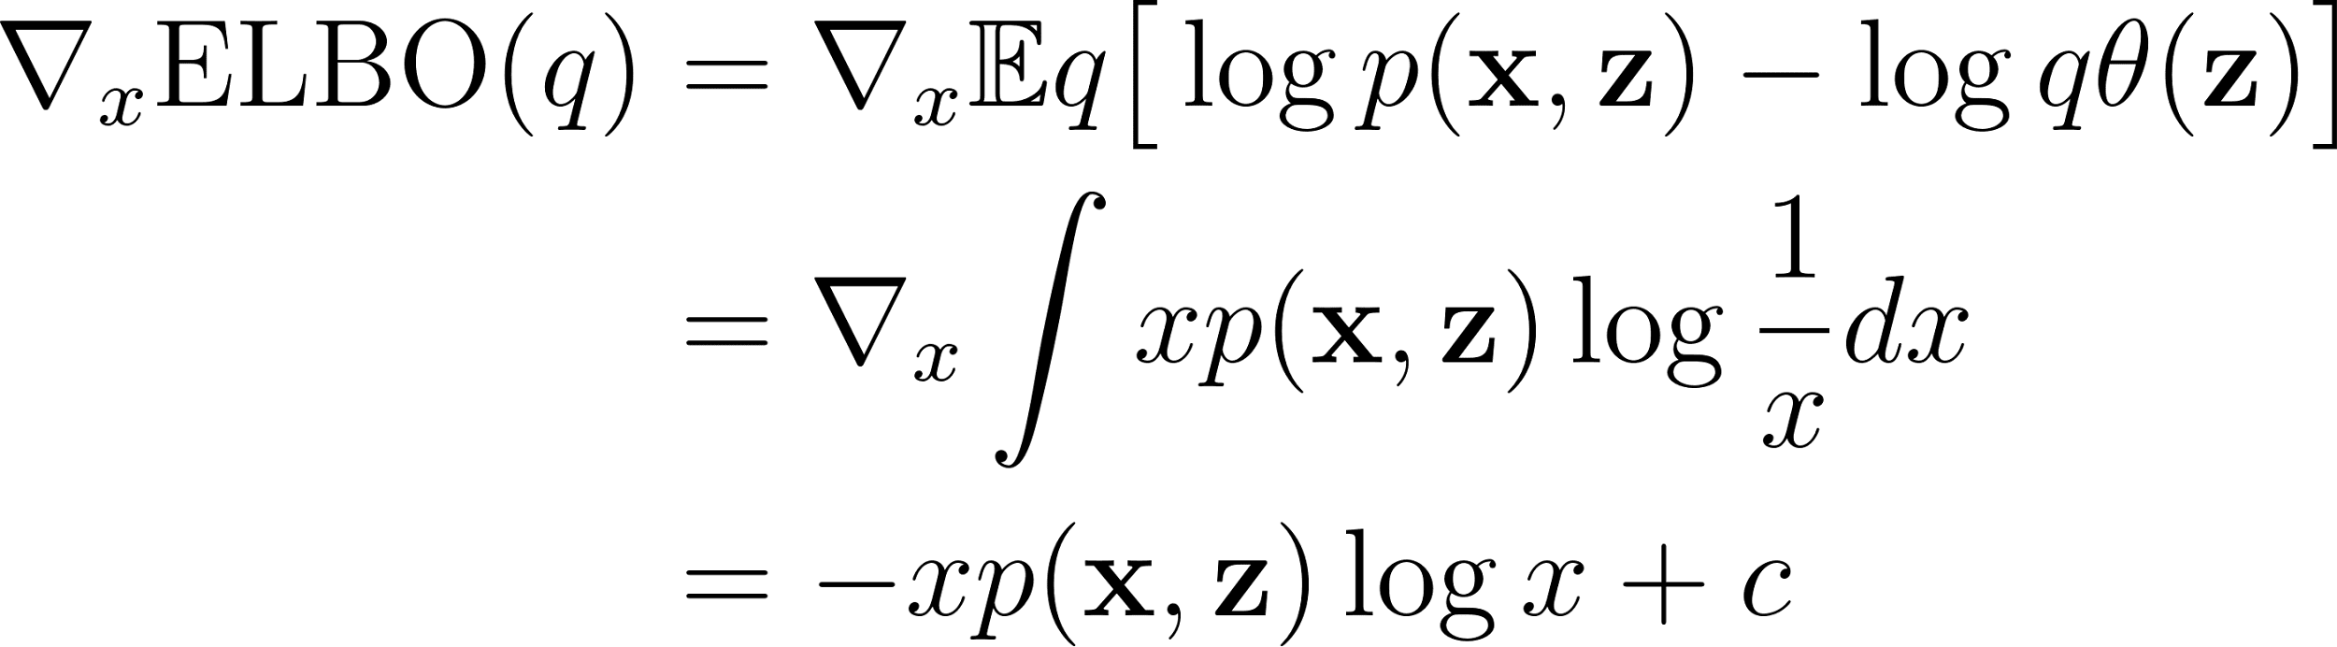
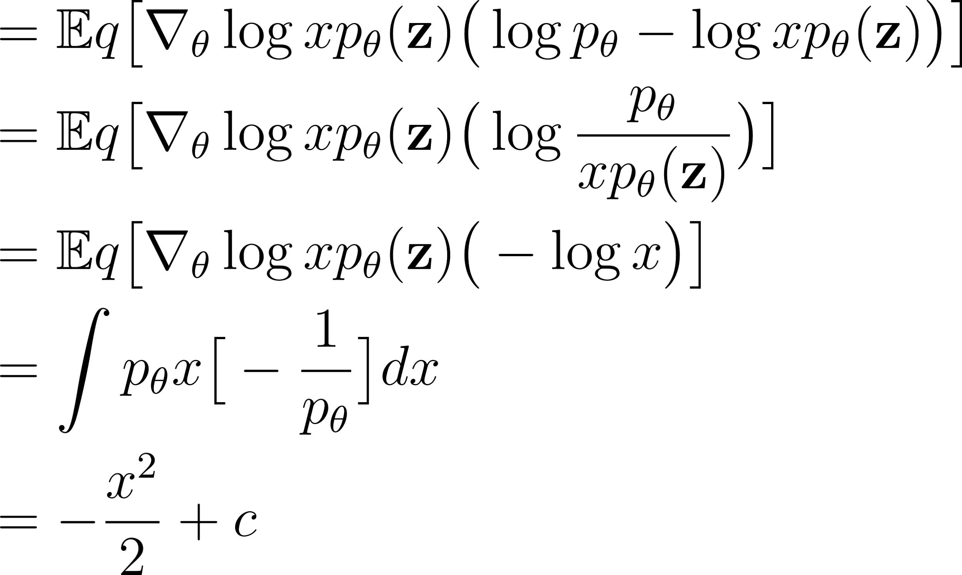
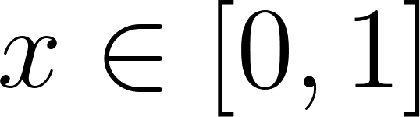
Observations
t_1
t_2

Slide 12
Conclusion
Characteristics of VI GMM model
Better performance
Fast converge
Multivariate normal distribution assumption constraints
Obtain optimal weights given by every iteration normal distribution

Slide 13
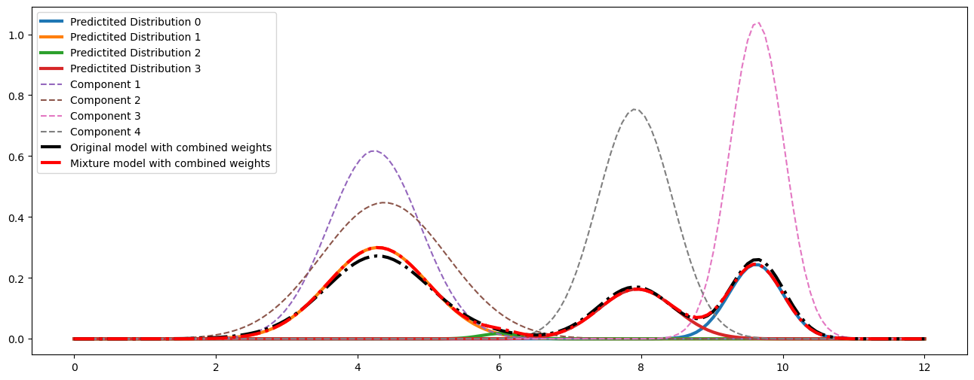
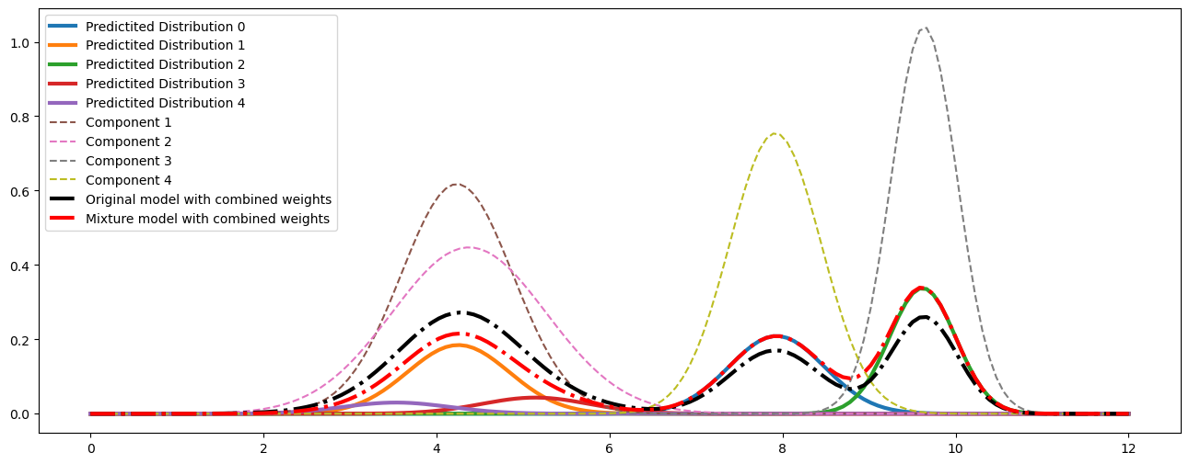
Vanilla GMM model
Underestimate
Variance
VI GMM model

Slide 14
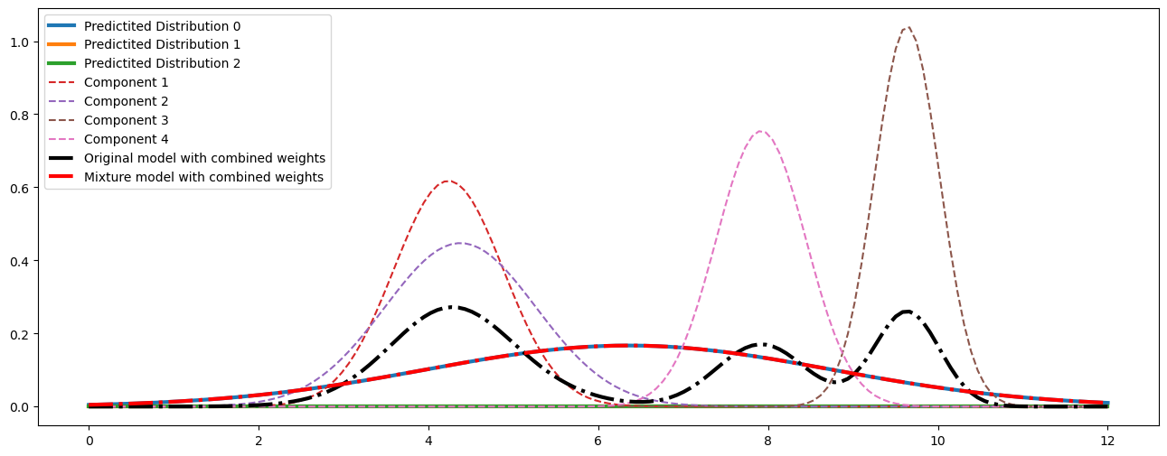
Maximum likelihood experiment
Only fit one line because of local optimality

